Slide 1
Bunch Detection using YOLO and FasterRCNN Deep Learning Architectures
Master’s Degree in Computer Science and Engineering
Computer Vision & Deep Learning (2022/2023)
Davide Camponogara VR472108

Slide 2

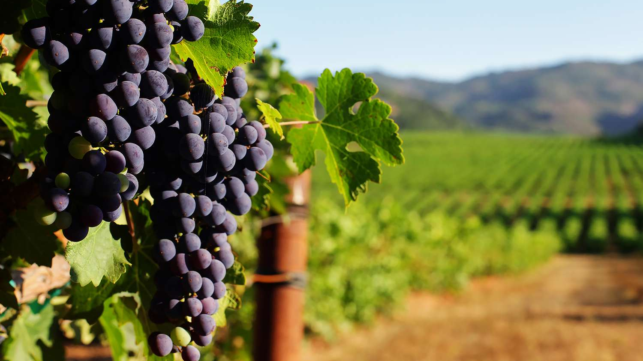
AI in viticulture
The use of artificial intelligence technologies in the agronomy is becoming always more important.
Deep neural network can now be trained on large datasets of many different types of crops, with excellent results.
Field owners can now monitor the health and growth of their land, increasing productivity.

Slide 3

Dataset and Data Augmentation

Slide 4
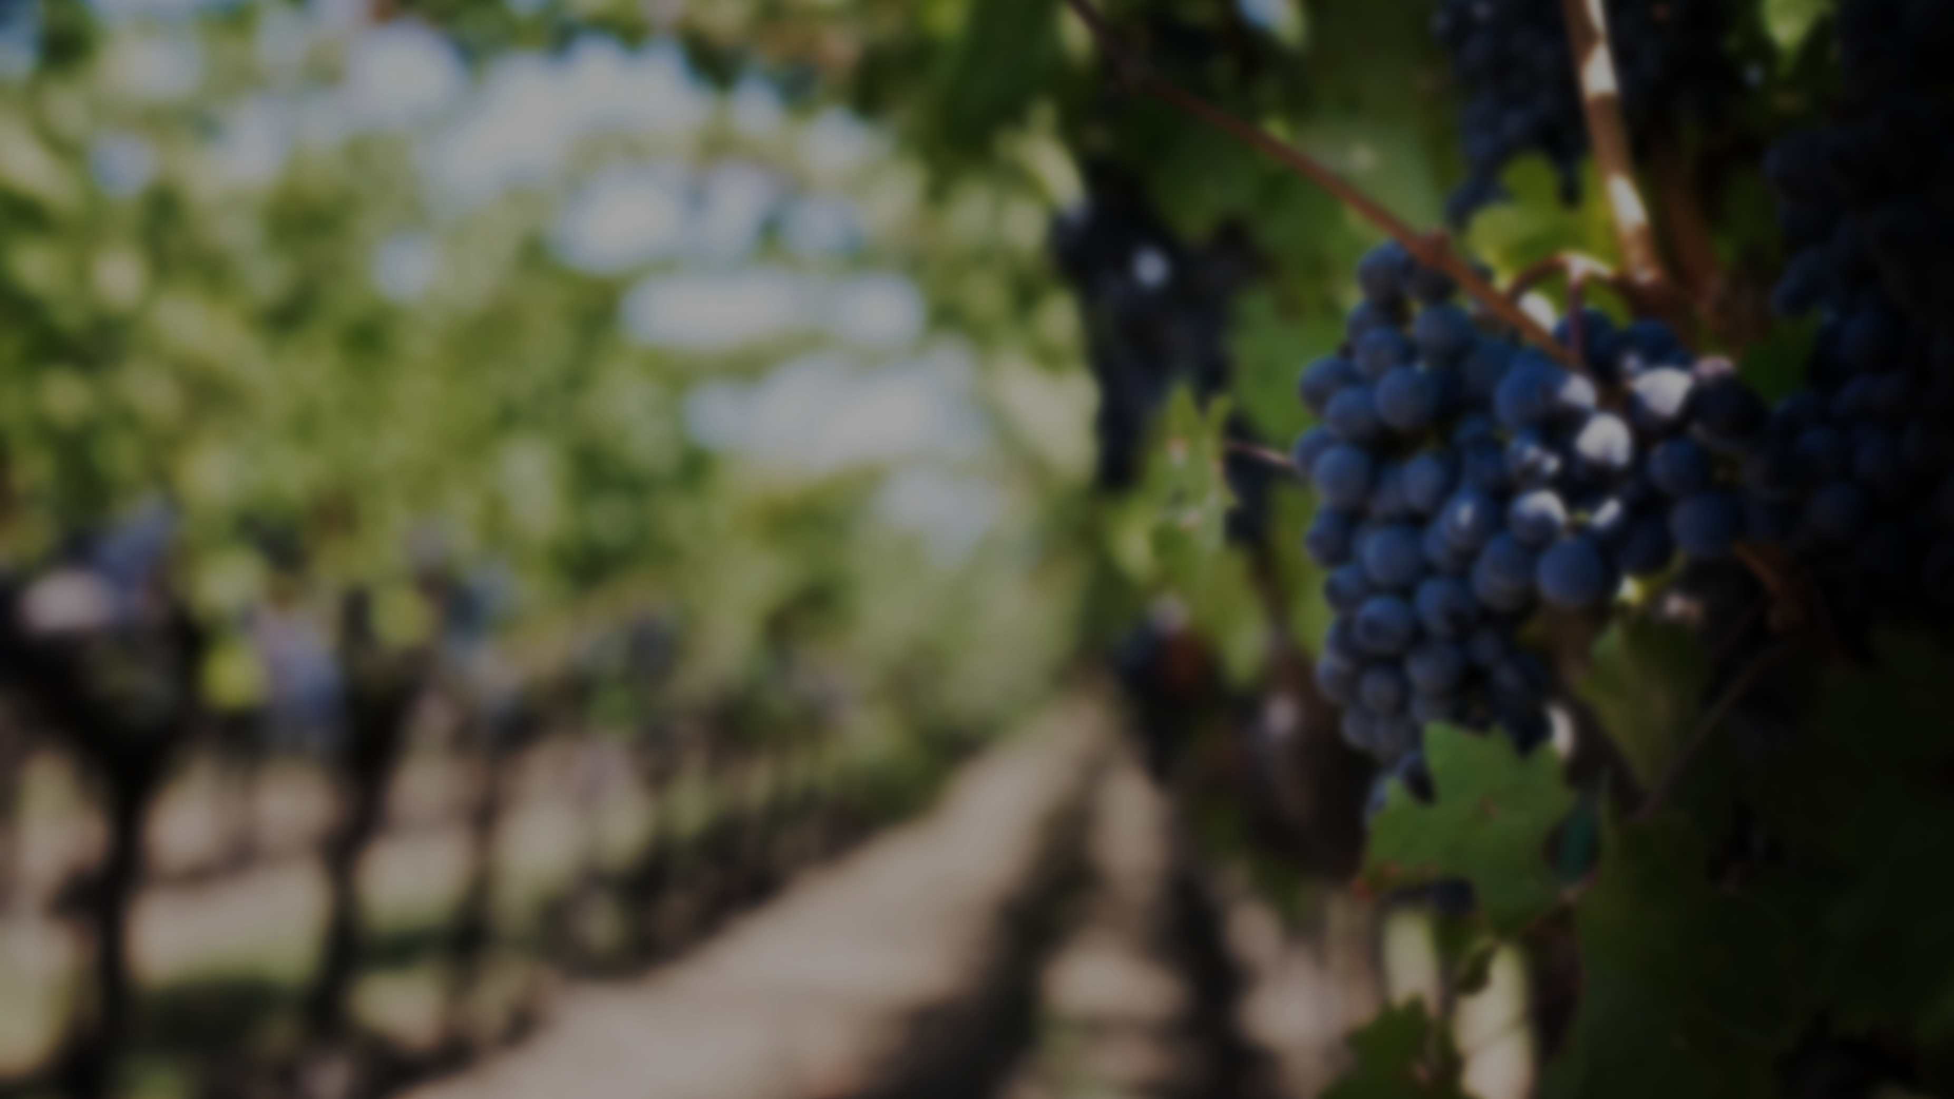
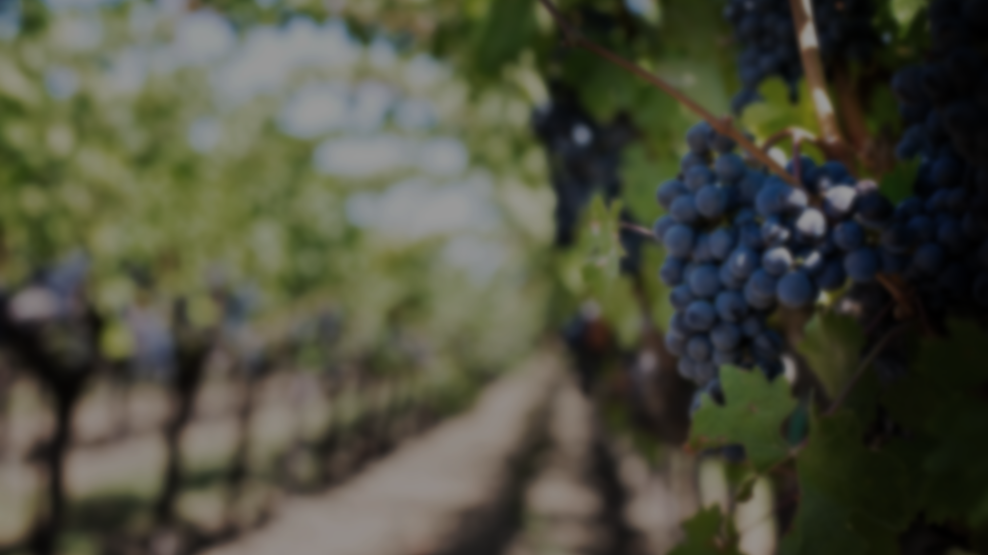
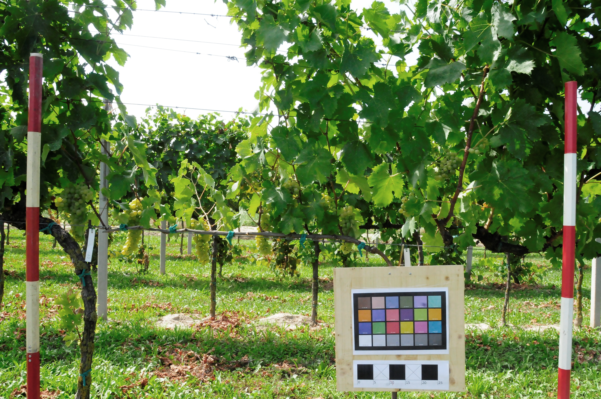
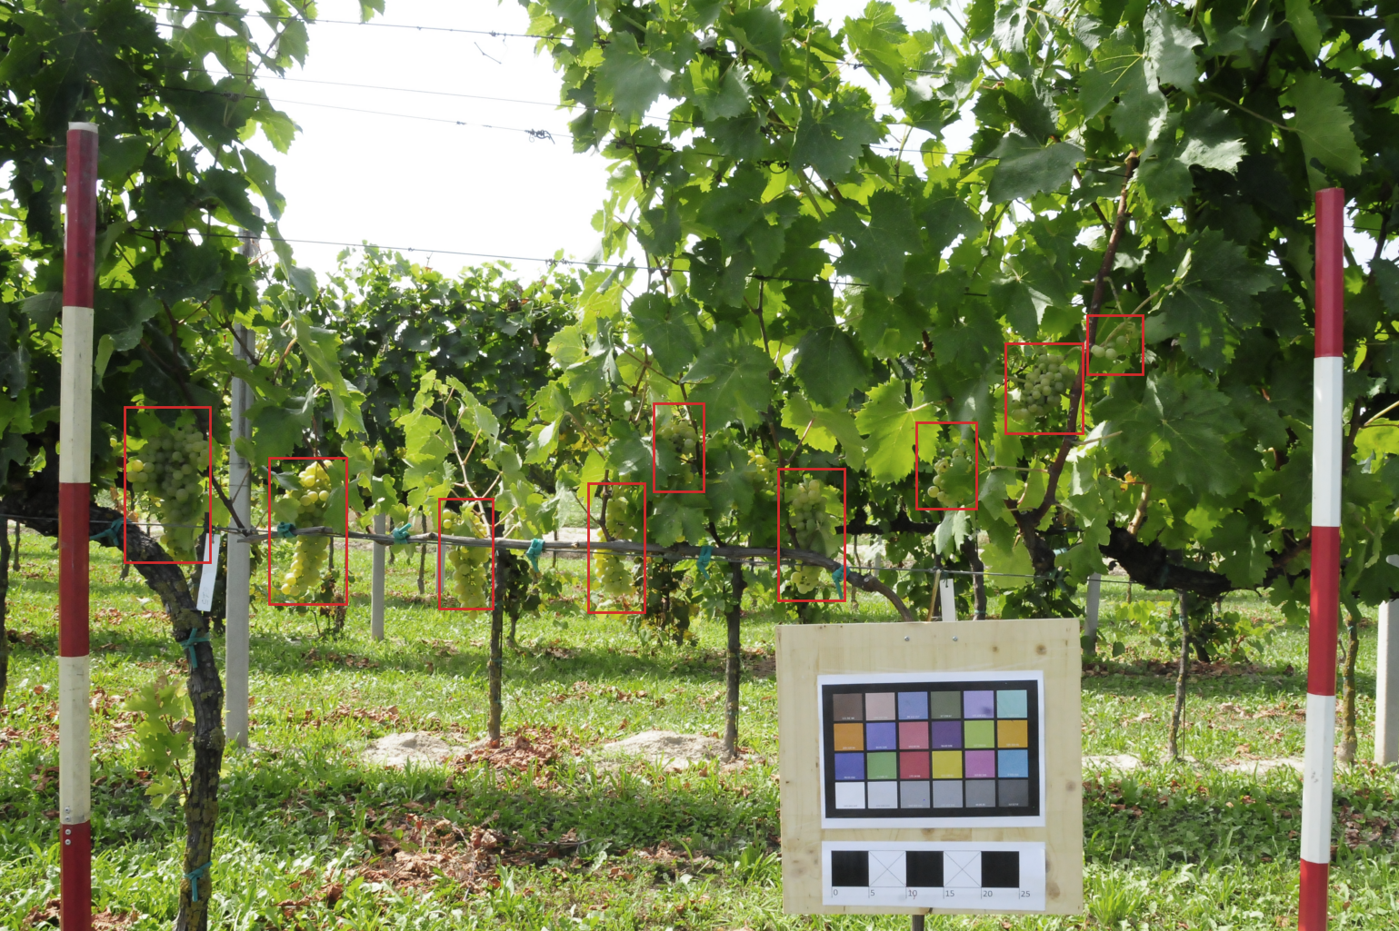
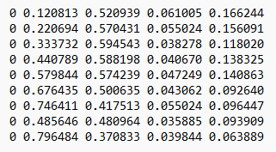
wGrapeUNIPD-DL Dataset
This dataset contains 373 images acquired from later view in vertical shoot position vineyards in six different Italian locations at different phenological stages. 270 images also have the YOLO labels.

Slide 5
Data Augmentation Techniques
Importance of data augmentation techniques in small datasets:
Avoid overfitting;
It increases the model’s ability to generalize;
It improves the accuracy of the deep learning model’s predictions.
We will briefly compare the results with and without data augmentation techniques.

Slide 6
Object Detection

Slide 7
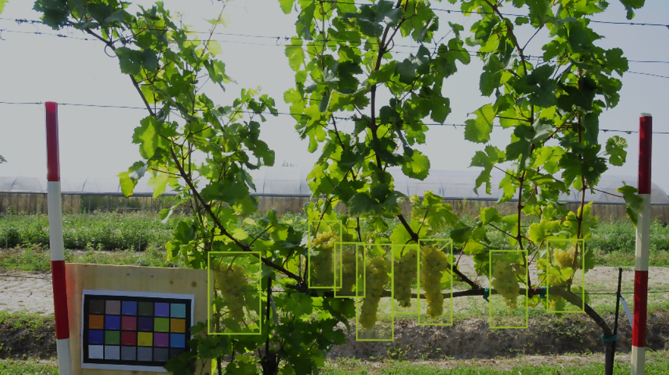
Object Detection in Our Project
The task of assigning a label and a bounding box to a objects in the image.
We compare the different bunch detection strategies, in particular we will focus on FasterRCNN and YOLO architectures.
We want to detect bunches of grape from images.

Slide 8

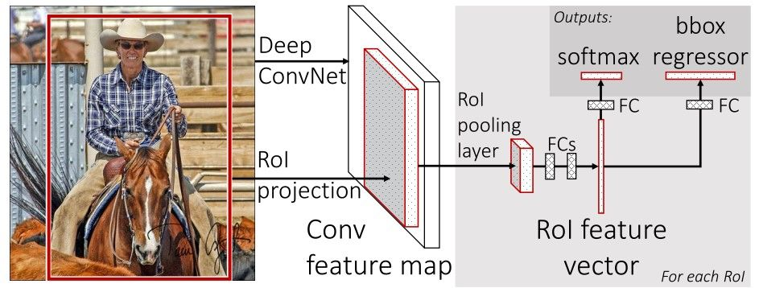
FastRCNN + ResNet50-FPN
Two modules:
Deep fully convolutional network as Region Proposal Network (RPN)
Fast R-CNN detector
‘Attention’ mechanism:
The RPN module tells the Fast R-CNN module where to look
Feature Pyramid Network:
Takes single-scale image of an arbitrary size as input, outputs proportionally sized feature maps

